Slide 1
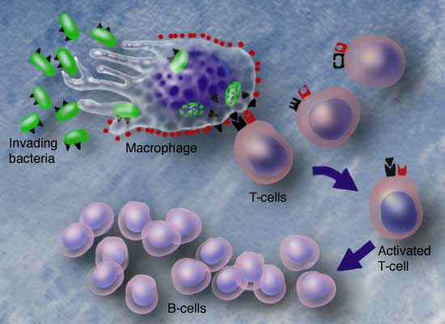
Cellular Immunity:
Notes:
A t-cell should never look at a cancer cell and see it as foreign because cancer cells are only our self cells.

Slide 2
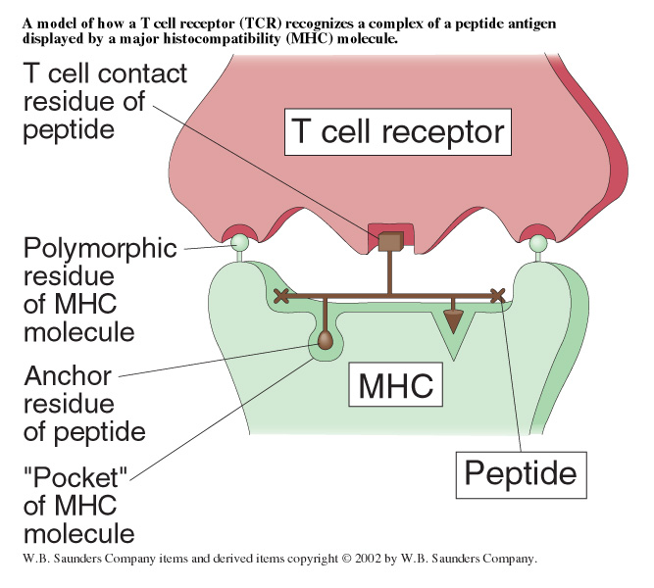
Figure 3-30
Cellular Communication is Vital for Specificity-
Combination of peptide and MHC molecule gives a topography of specific surface that the TCR recognizes.
Notes:
An antigen presenting cells has to talk to a t-cell and does so via an MHC receptor. Communication occurs in the junction where they transmit signals and t cell is allowed to be activated. All the cells can serve this roll as an APC.

Slide 3
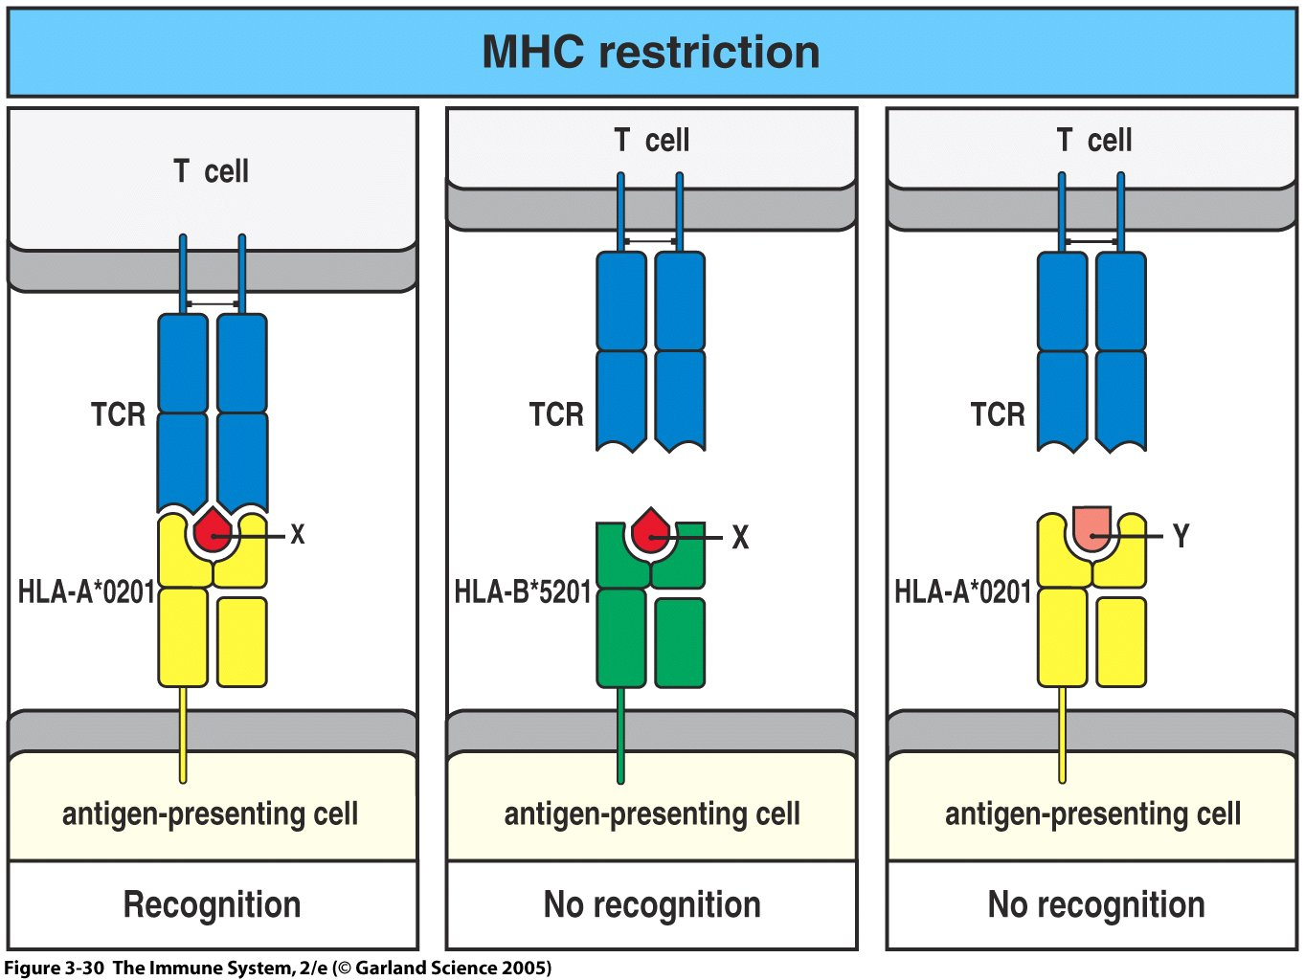
Figure 3-30
Even a one amino acid difference in peptide or MHC can completely abrogate the ability of a TCR to be activated.
Notes:
A single amino acid change can either decrease efficiency or eliminate binding capability

Slide 4
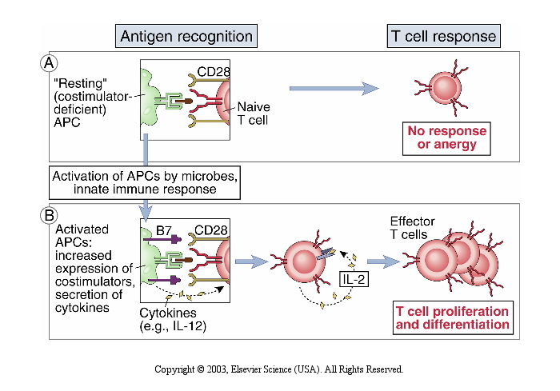
Notes:
Two types of interactions:
Naïve- MHC presenting antigen to t-cell receptor (cd4 or cd8). When we talk about t cell receptor interacting with MHC t
Signal one cd4 or cd8 and TCR binding to MHC cleft. That gives initial signal.
IF MHC is holding inapprpriate antigen for the protein or has self protein there will be no response or anaergic.
T Cell has CD28/B7 is the second signal and allows for robust activation and allows t cell to become effector t cell.

Slide 5
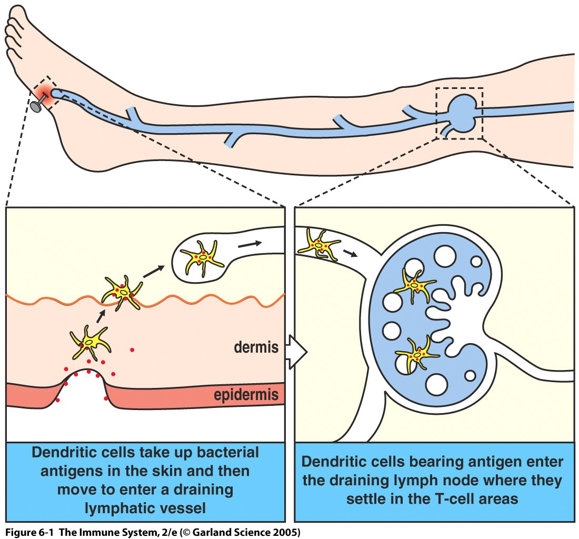
Figure 6-1
Immature dendritic cells upon stimulation lose affinity for tissue and start to mature
Will migrate to draining lymph node
Mature on the way
Become professional antigen presenting cell in lymph node
Notes:
Decdritic cells do not want to leave homes originally until they are activated and then they will circulate to the nearest draining lymph node. They will move to the t-cell zone.

Slide 6
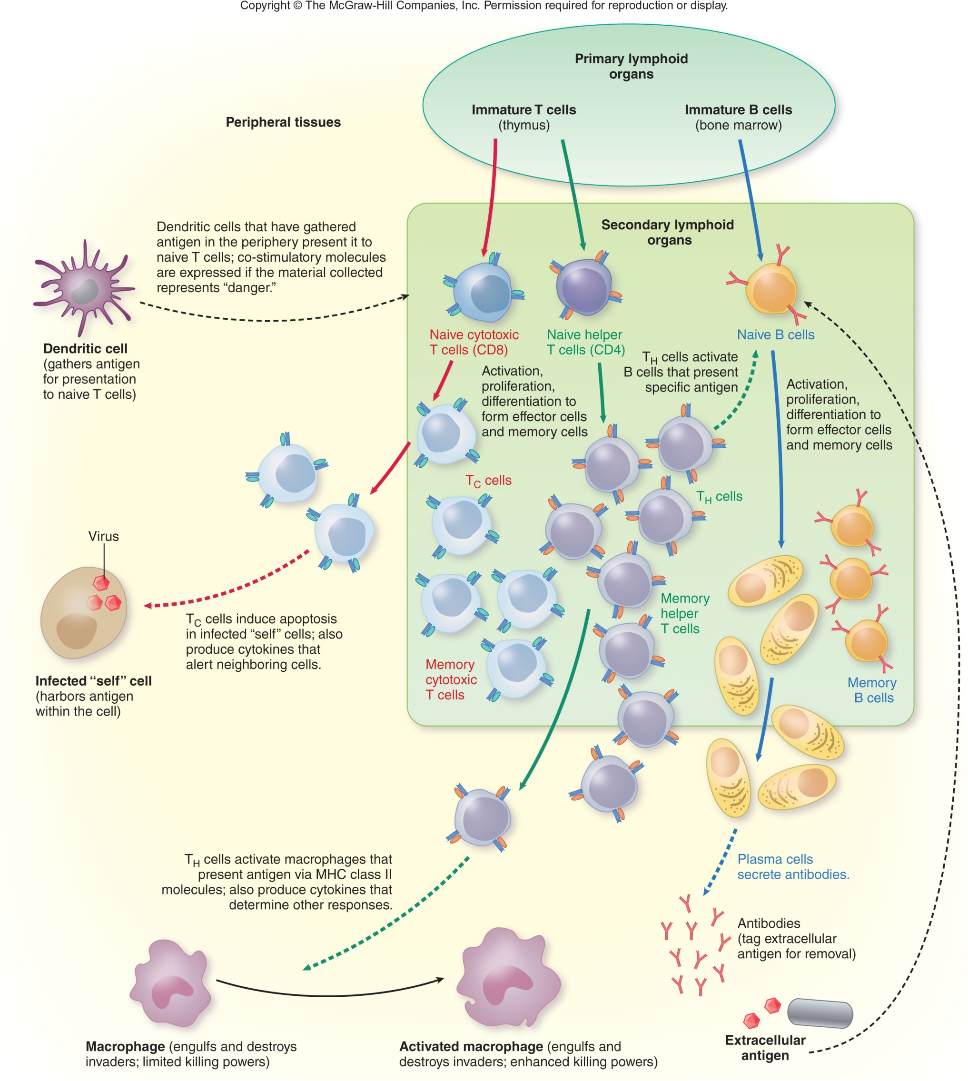
Fig. 16.1
Notes:
MHC class I mole The McGraw–Hill Two types of t cells.
Only APCs such as DC or macrophages carry mhc class II. This are professional APCs.
Class I
All nucleated cells carry MHC class I. Only a few cells carry MHC class II. This is very important for the roles that they serve. MHC II actives helper T cells MHC class one actives CD8 cells. Every nucleated cell in our body might be a cell that needs to be lysed so they all carry MHC class I. Class I can demonstrated to CD8 t-cell that there is aproblem in that cell. MHC II can take a foreign piece of the protein to amplify and provide the response.

Slide 7
4
8
8
Th cell
Tc cell
4
8
4
8
Naïve Cell Activated By
APC
APC
Receptor
TCR
TCR
Co-receptor
CD4
CD8
Binds to
Class II
Class I
Function
Produce
cytokines
Kills

Slide 8
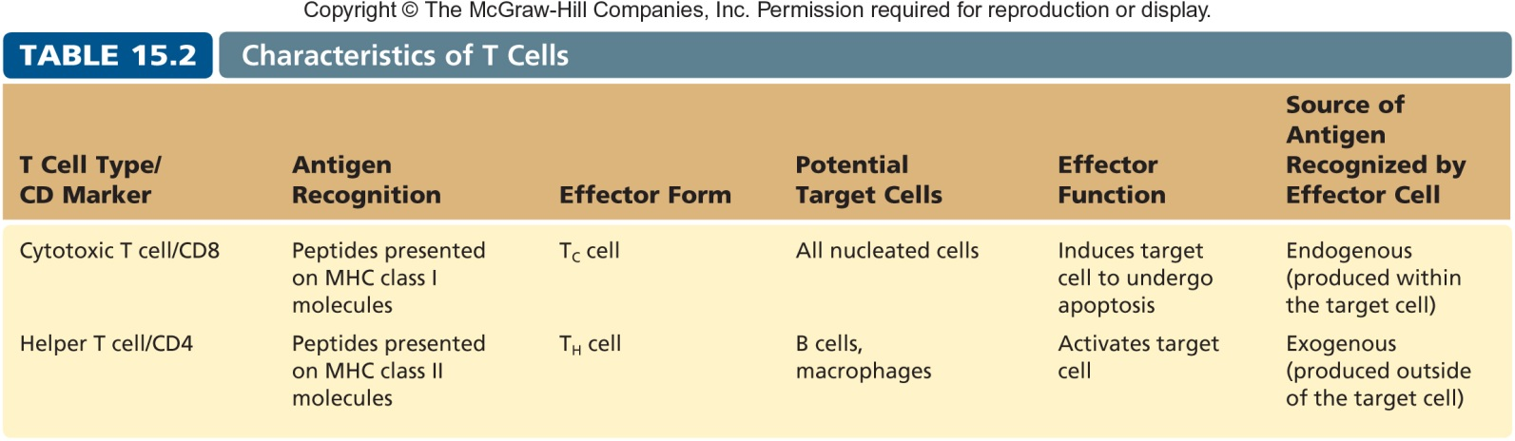
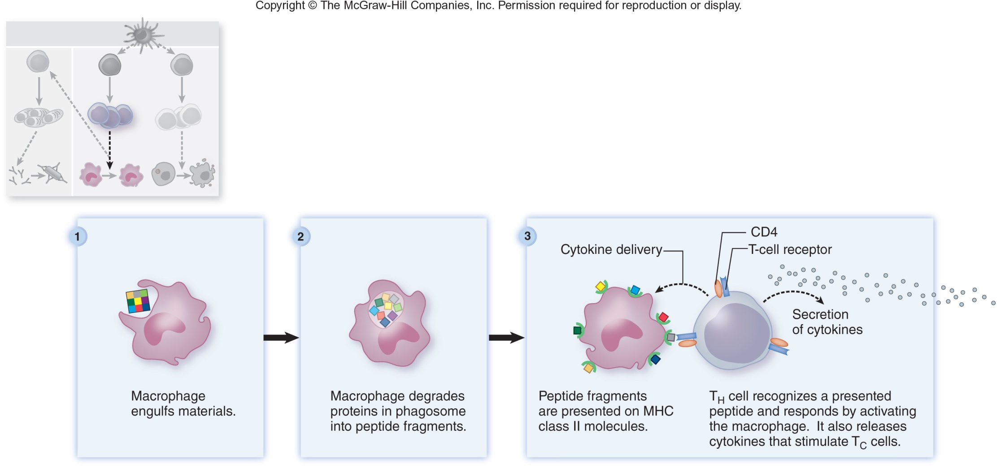
T_{H} 1 cells
B7/CD28
APC/T cell

Slide 9
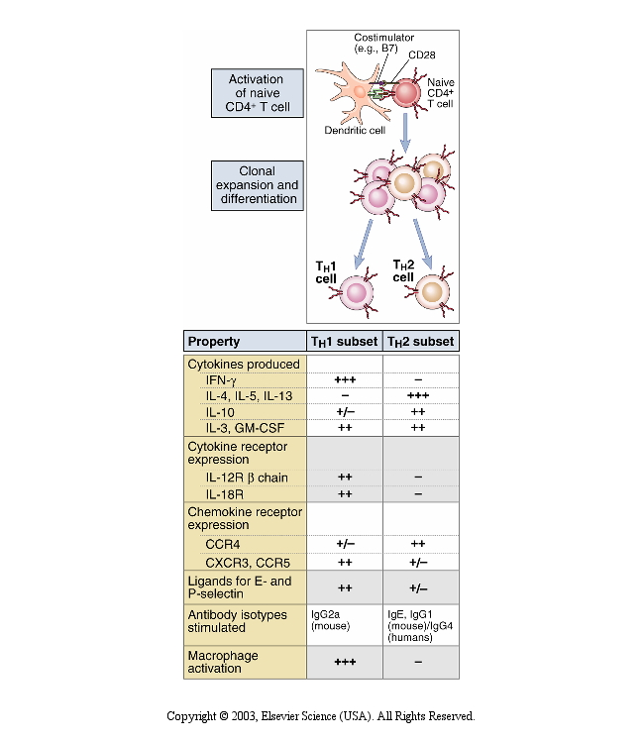
Notes:
We always through thtese divided into Th1 and TH2. These are cytokines that cells secrete to trigger specific repsonses. TH1 more inflammatory response TH2 more inflammatory response. But, there are actualy different shades of TH cells (see next slide)

Slide 10
The many flavors of T_{H} cells
T_{H} 1 cells
Become T_{H} 1 cells when the APC tells it that a
cytolytic response is needed. IL-2, IFN-γ
T_{H} 2 cells
Become T_{H} 2 cells when an APC tells it that a
humoral response is needed. IL-4, IL-5, IL-13
T_{H} 17 cells
Activate the innate immune response, especially neutrophils. IL-17
T_{REG} cells
Stop the immune response from continuing. IL-10 and TGF-β
Notes:
People lacking Treg have higher incidence of autoimmune disease.

Slide 11
4
Th cell
4
4
CD28/B7
Tcell/APC
Notes:
Yellow is CD4. THC is binding MHC II then there is a B7 binding to CD28. Secretes cytokines (purple ovals.

Slide 12
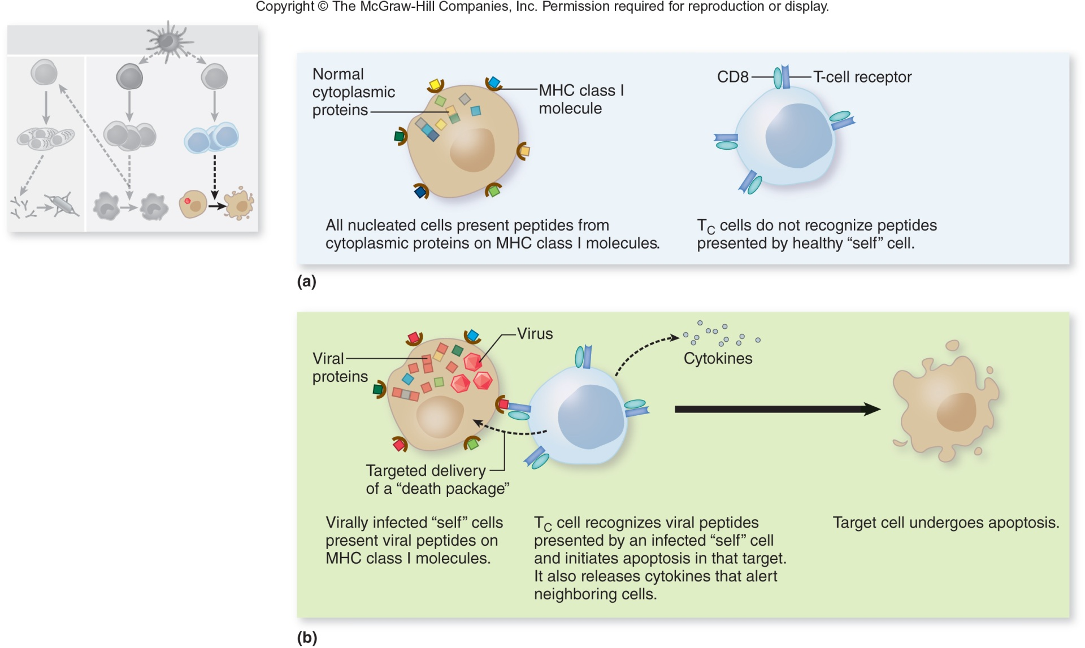
Granzymes
Perforins
Notes:
CD8 is also important. The interaction betwee the APC and CD8 is coming from MHC I. MHC I interacts with

Slide 13
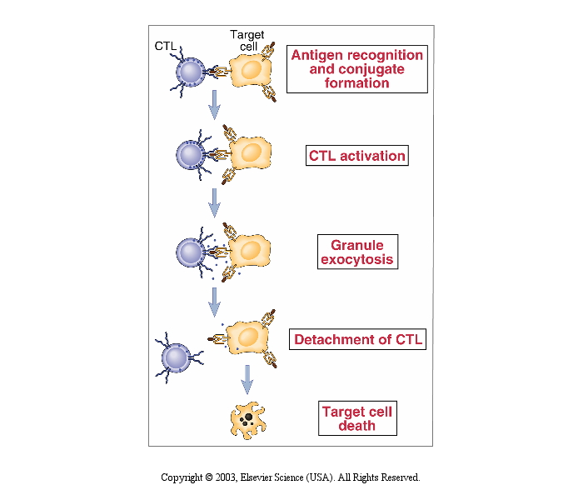
Granzymes
Perforins
Notes:
Granule exocytosis-> shoot holes into the cell that is carrying MHC I flag. Then the cell dies.

Slide 14
8
8
8
8
Tc cell
8
8
8
8
CD28/B7
Tcell/APC
8
8
8
8
Tc cell
8
8
8
8
1
1
1
1
1
1
Notes:
Octopus, dendritic cell. CD8 and TCR interactins with MHC I B7 and CD8 activates CD8 cell. CD8 finds cells that present MHC I molecule and kill those cells.

Slide 15
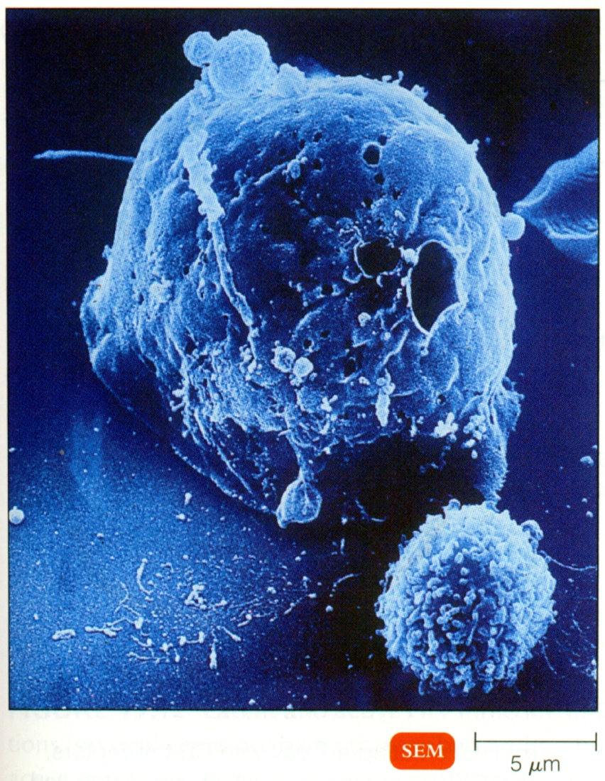
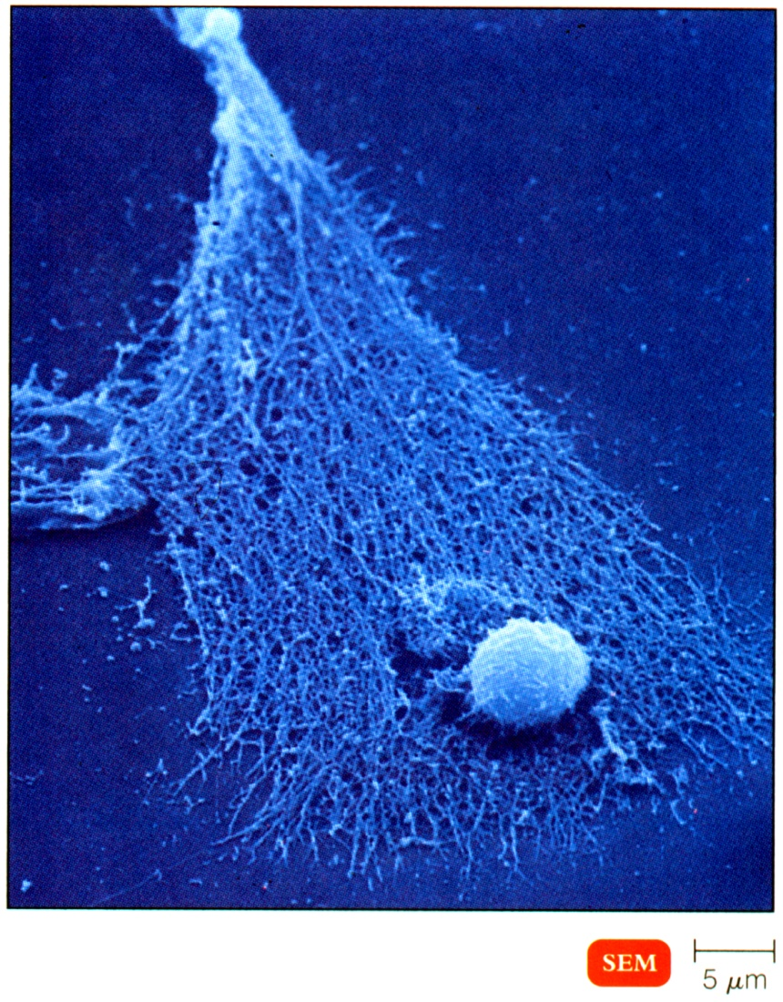

Slide 16
4
Th1 cell
8
8
8
8
4
Tc cell
8
4
8
8
8
8
8
8
8
Tc cell
8
8
8
8
1
1
1
1
1
1
Notes:
Th1 is CD4 cells. And then they say wait, I need CD8. then the DC interacts with CD4 and CD8 and interact with MHC I and MHC II. CD4 secretes inflammatory cytokines helping to active CD8 cell. CD8 cell then has added boost and then can find invader cells better. MHC I is Tc (CD8) MHC II (CD4) is Th1.
Cognate antigen (specific antigen). Until it sees its specific antigen. Each cell has its own antigen, which is to say it has its own cognate antigen. This is the case for both CD4 and CD8. There is no crossover with antigens because what they are lookin for is different. It is looking for different length of antigen that it is looking for.
T-helper (CD4) -> TH1, Th2, TH4, TH reg.
Cytotoxic (CD8)
All work in coordinated way to clear cell medaited infection

Slide 17
8
8
8
8
Tc
Memory
8
8
8
8
1
1
1
1
1
1
Notes:
Now, a memory cell is produced. Your CD8 memory cell doesn’t need antigen presentation. Memory cell will kill microbe dead.

Slide 18
Signal 1 without Signal 2
Anergy or deletion
8
8
8
8
Naive
Tc cell
8
8
8
8
1
1
1
1
1
1

Slide 19
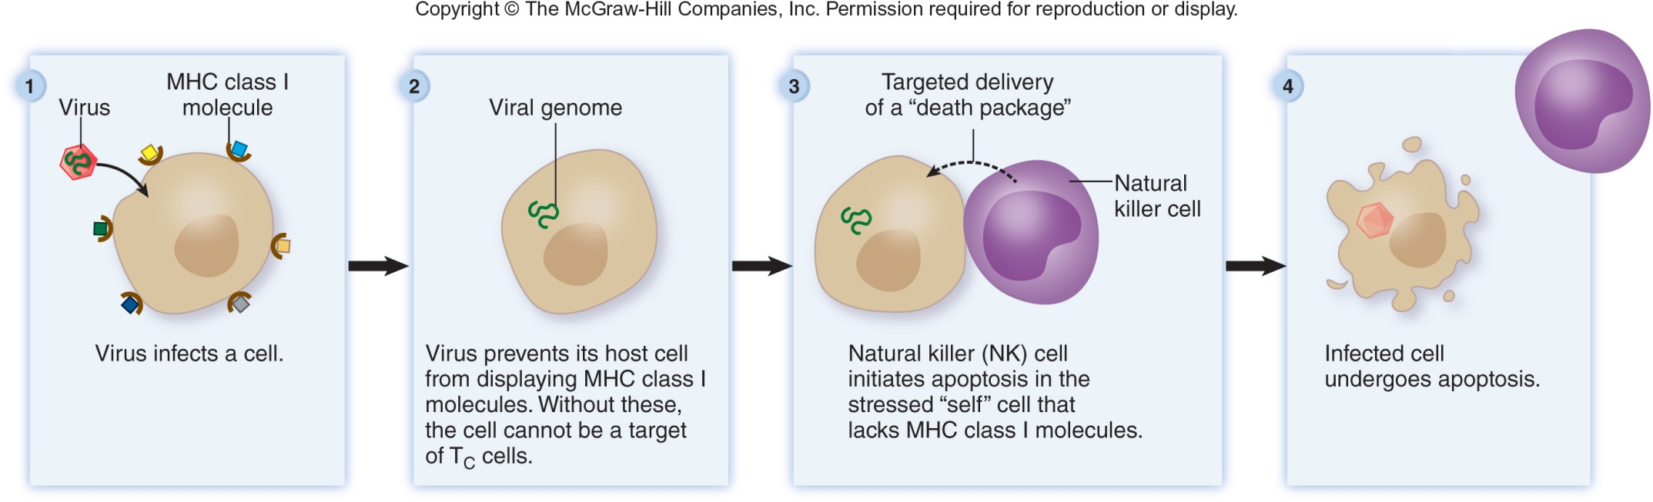
Natural Killer (NK) cells
Are large granular lymphocytes that are not T or B cells and are part of the innate immune response.
They look for nucleated cells that DON’T HAVE
MHC class I molecules on their surface.
Also function in ADCC

Slide 20
